Slide 1
Rethinking Poverty
Cj Wang
Bahá'í International Community

Slide 2

What is poverty?
UN Definition of Poverty:
“Fundamentally, poverty is a denial of choices and opportunities, a violation of human dignity. It means lack of basic capacity to participate effectively in society. It means not having enough to feed and cloth a family, not having a school or clinic to go to, not having the land on which to grow one’s food or a job to earn one’s living, not having access to credit. It means insecurity, powerlessness and exclusion of individuals, households and communities. It means susceptibility to violence, and it often implies living on marginal or fragile environments, without access to clean water or sanitation”
(UN Statement on commitment of the Administrative Committee on Coordination for action to eradicate poverty, June 1998)

Slide 3
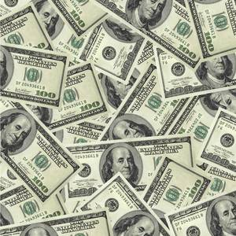
Current Approach
Poverty-line approach
Poverty is measured in monetary terms and captured by levels of income or consumption per capita or per household
Ex. World Bank's $1(PPP)-per-day poverty line

Slide 4

Problems with the
Poverty-Line Approach
Methodological Problems
  Which line to use?
  How to quantify people’s basic needs?
  How to treat households?
Fatal conceptual assumptions
  All dimensions of poverty can be quantified in monetary terms.
  People have access to services and resources at any time at any place.

Slide 5
Methodological Problems:
Which line to use?
In Rural India:
are extremely poor (<$1(PPP) per day)
are vulnerable to poverty (<$2.2(PPP) per day)
In Wuding County, Yunnan, China:
(< official poverty line – 667 Yuan per year)
(< adjusted-for-local-price line – 1,296 Yuan per year)
(< poverty line according to local perception – 2,315 Yuan per year)
6.4%
81.9%
3.4%
18%
59.6%

Slide 6
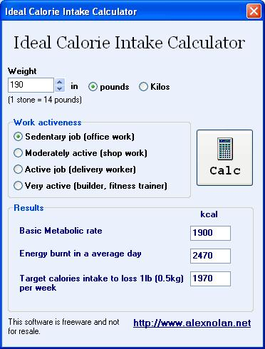
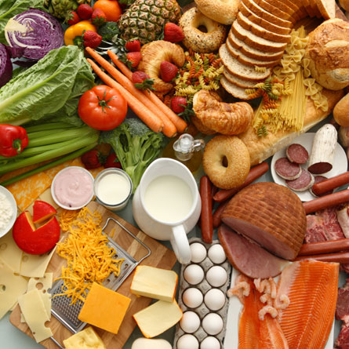
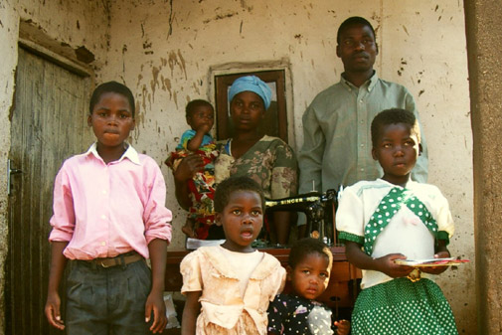
How to quantify people's
basic needs?
Food Component
Non-Food Component

Slide 7
How to treat households?
Some households sell their properties to meet their short-term necessities.
2. Some households keep their children at home to support their families.

Slide 8
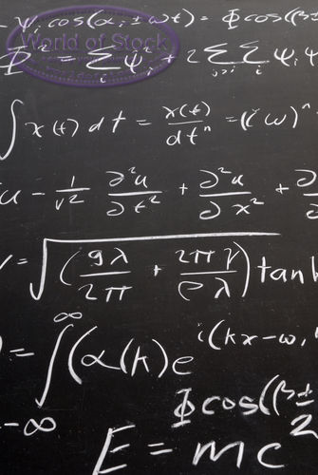
Fatal conceptual assumptions
1. All dimensions of poverty can be quantified in monetary terms.
  Sustainability
  Volatility
  Inequality
  Relational dimensions
2. People have access to services and resources at any time at any place.

Slide 9
Summary
Measurements are not guarantees for meanings and relevance.
Many people who are vulnerable to poverty are overlooked.
Inequality falls out of the discussion.
All relational dimensions are missing.

Slide 10

Alternative Approach:
Social Exclusion Approach
Look at groups rather than individuals and households
All relational dimensions are incorporated.
Inequality enters the discussion.
People who are above the poverty line but are vulnerable to poverty are taken into consideration.

Slide 11

Possible Social Groups to Look At
Ethnic minorities
People of color
Women
Migrant workers
Immigrants
Children
Disabilities
Elders

Slide 12
Case Study – The Oglala Sioux People on the Pine Ridge Reservation
More than half of the population live below the poverty line and nearly one third live below half of the poverty line.
Residents must travel 40-180 miles to meet their banking needs.
An unmet need of small business capital at over $10,000,000.
Mortality rate is more than twice the national average.

Slide 13
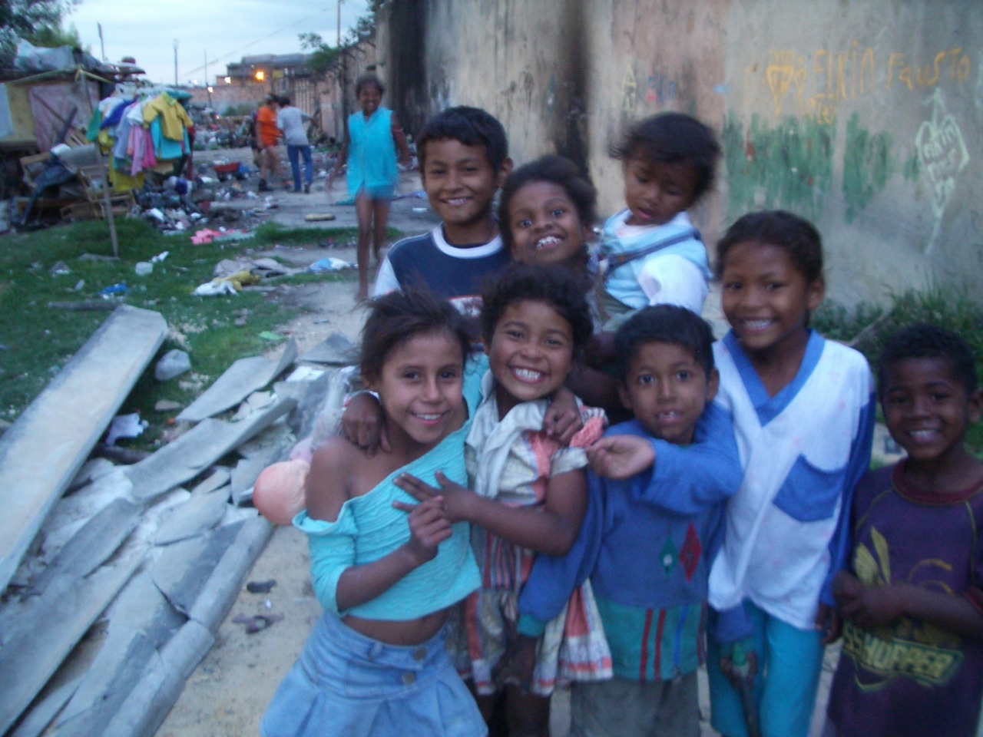
THE END

