Slide 1

Informal Working Breakfast on
Migration and its impact on the implementation of Agenda 2030
Bela Hovy, Chief
Migration Section, Population Division
Department of Economic and Social Affairs (DESA)
United Nations, New York
Co-convened by the Bahá’í International Community
and the International Movement ATD Fourth World
866 United Nations Plaza, Suite 120
Wednesday, 8 June 2016
Notes:
1
1

Slide 2
Who is an international migrant?
(United Nations, Department of Economic and Social Affairs, Statistics Division (1998). Recommendation on statistics of international migration. Rev.1.)
Any person who changes her / his country of residence
  Part of this definition:
    a move
    minimum duration of stay (long-term vs. short-term)
  Not part of this definition:
    purpose / reason (work, family, study, asylum, etc.)
    Legal status
  Main data source: population census
    Foreign-born (country of birth)
    Foreign citizen (citizenship)

Slide 3
1. The number of international migrants is likely to increase
International migrant stock, 1990-2050 (millions)
Proportion of international migrants in total population
2000-2010
growth rate
2010-2015
growth rate
3.3%
3.2%
2.8%
1990-2000
growth rate
2.9%
1990
2000
2010
2015
2050
Source: UN/DESA, Population Division (2015).
Trends in International Migrant Stock: The 2015 revision
Notes:
3

Slide 4
2. The role of migration in overall population change is likely to increase
Millions
Millions
Total net population change
Immigration-emigration
Births-deaths
Source: UN, DESA, Population Division (2015).
World Population Prospects: The 2015 Revision
Notes:
4

Slide 5
3. Differences in the change of the working age population will increase between some regions (2015 – 2050)
Source: UN, DESA, Population Division (2015).
World Population Prospects: The 2015 Revision

Slide 6


Slide 7
2030 Agenda for Sustainable Development
Strengthen and retain health work force in LDCs (3.c)
Provide scholarships for study abroad (4.b)
Protect labour rights of migrant workers (8.8)
Facilitate orderly, safe, regular migration through well-managed migration policies (10.7)
Reduce transaction costs of remittances (10.c)
Provide for legal identity, incl. birth registration (16.9)
Eliminate human trafficking (5.2; 8.7; 16.2)
Disaggregate data (by migratory status, etc.) (17.18)

Slide 8
Addis Ababa Action Agenda
(means of implementation of 2030 Agenda)
  Migration
  Portability (acquired rights, foreign qualifications)
  Abusive recruitment practices (e.g. costs)
  Combat xenophobia and facilitate integration
  Remittances
  Reduce transfer costs
  Address adverse consequences AML/CTF
  Competition/new technologies/transparancy
  Financial literacy and inclusion

Slide 9
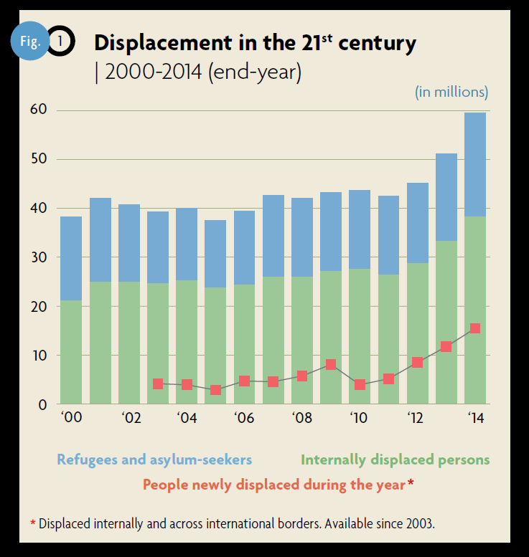
Refugee trends, 2014

Slide 10
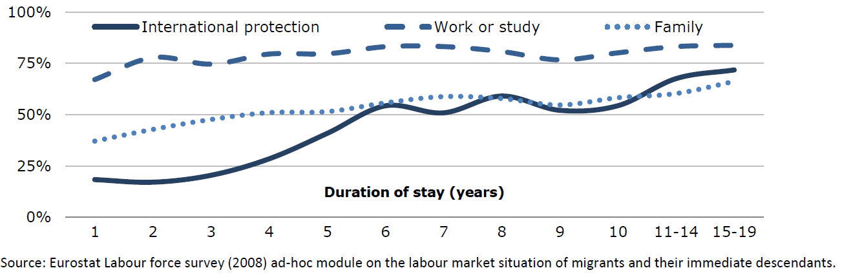
Labour market integration takes time and depends on entry category (EU-28)

Slide 11
4. Responsibility sharing for refugees is uneven
Ratio of refugee population to gross
domestic product per capita (PPPs)
Source: UNHCR Statistical Yearbook 2014, Annex Table 26.
Indicators of host country capacity and contributions, end-2014

